Slide 1



ACHARYA HACKATHON
Organized By Acharya Institutes, Bangalore

Slide 2
Table of contents
01
02
03
04
05
06
Virtualizing medical field
Promoting instant clinical help
requirements
Promoting self health care and instant health services
License, developmental funds, marketing funds, database
24/7 in-hand clinic like help at low cost
COMPETITION
Tech-ida
Available for rural areas also
Serving the most feasible & effective solution even through all competitive aspects.
Introducing smarter form of medi-tech in the rustic areas
Low cost feasible health checkup option with efficiency

Slide 3

01
virtuohealth
Need to safe keep your health?
Tired of the same google answers?
We are here to help you with our efficient and accurate advice validated by the best doctors at a very feasible cost.

Slide 4
About the project
However you are feeling, you could openly convey it to an AI chatbot, in a very much human interactive language, the common English, and it’s 24/7 ready to detect your illness & irregularities. Just got detected? Need not panic, it will even help you with immediate remedies & solutions, so you could be alright passively.

Slide 5
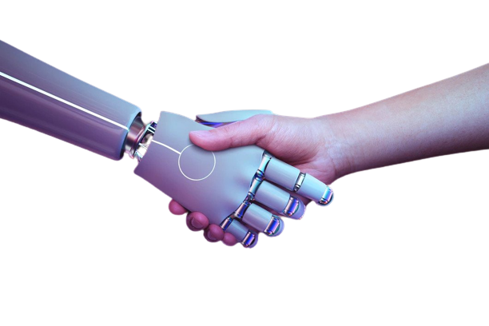
Now - problem
Even in 21st century, getting instant clinical help, relief, remedies and care has been a concern, even with the upgrading medical sciences, especially in the rural areas.
Building trust in the Medi-tech systems was also never successful till date.

Slide 6

Future
An AI CHATBOT System:
• Collects data of the symptoms of a patient.
• Automatically detects illness
• Sets recommendations about patient’s care.
• Uses algorithms, EMR data to serve accurate solutions.
• Setting up virtual clinic in rural areas with the low cost – high grade checkup.
• Providing immediate assistant 24/7 even in remote areas.

Slide 7

Major requirements
02
Huge Database of:
Symptoms
Diseases
Remedies
Possible cures
Medical license
Clinical validation of the database
Developers frequent updating of AI for more precise solutions

Slide 8

Project goals
03
Our main goal is going to be to introduce all time self assistance so that even when doctors are not available an individual can receive an accurate cure.
- To provide relief and confidence to an individual.
- Introduce symptom check and diagnosis solution so that a person can elaborate on what they want to discuss about.
- To make an algorithmic treatment database with a million data into deep learning and algorithms into most appropriate treatment and care.
- To reach out to people in the remote areas with the best treatment possible in the least cost available.

Slide 9

In this growing urban world we often forget about the rural side where most of the facilities are downgraded so the one most important thing that we are providing through our project is the virtualization of the rural world in medical field and keeping their financial state in mind we are going to make it accommodable. There are many upgrading technologies related to the medical section. What we focus on is accuracy and efficiency of the smallest things like self health assessment and instant clinical help within the financial reach of every commoner.
NOVELTY ADDED TO YOUR PROJECT
04

Slide 10
Budget plan for making your project in working condition
Initial Funding Required: Rs.5-6lakhs
We consider this funding as a cash burn for the first 3 months expenditure.
We have expenses on Rs.1lakh Developer Fees, 25K on doctor’s validations, 50K on marketing monthly.
Apart from this we spend around Rs.25000/- for medical licensing of our product, annually.
BUSINESS PLAN:
We expect around 5000 user base.
We charge people an approx. amount of Rs.75/- per usage, estimating a monthly usage of 3500 times minimum from this 5K user base. [Estimated Earning: Rs.2.6lakhs per month]
We give free service for the initial days, in order to adapt & accommodate people to our service.
We serve the rural area through grounded virtual devices, setup for common use by the villagers, not being charged individually, but we charge roughly around Rs.5000 per month from the Panchayat’s, a part of the Government Development Funds. (PM Rural Development Fellow Scheme) [Estimated Initial Earning: Rs.50thousand per month] | {Profit Base: Nearly 1 lakh per month}

Slide 11

Outstanding the competitiors
05
We do not have competitors to serve the same product, as of now.
However, with the upcoming AI generation, similar products might be available.
Yet, we can strive to stay the best in the market because we focus entirely on accuracy and efficiency of the smallest things, grounding our goal to make instant healthcare available for every commoners.
We keep on updating its providence to maximise the outcome everyway possible.

Slide 12

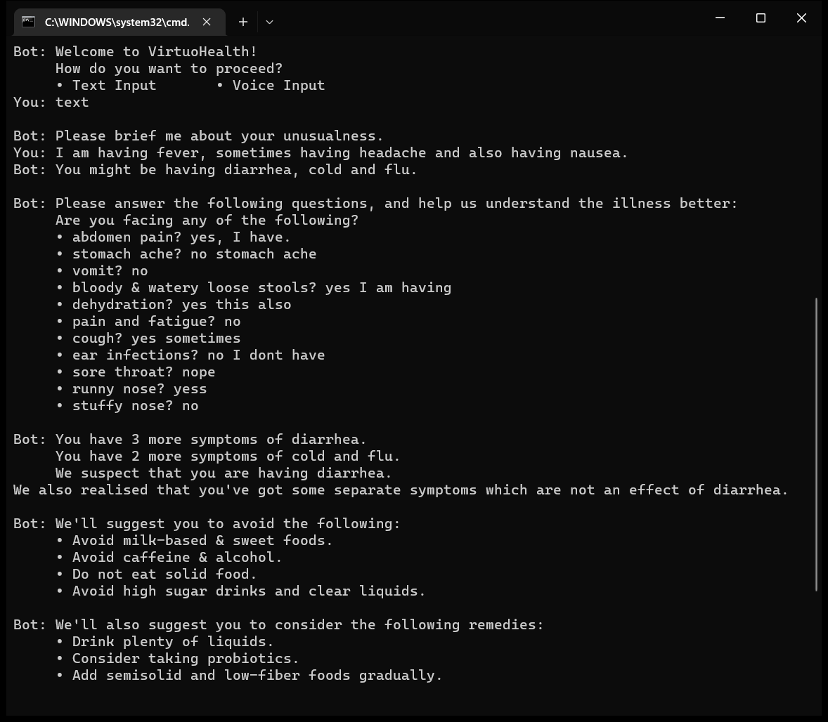
A LITTLE DEMO
We have also built a working prototype and would like to show you…

Slide 13
Team : Tech-ida
06
VIRTUOHEALTH
SAYAN DAS – CSE
SANJANA PRASAD – CSE
ARUN C.A – Nursing
GEO SIPY – Nursing
Mentor: RAMYA B

